Slide 1

Online store
made by: Aldazharov Merey, SE-2016
EP PROJECT

Slide 2


AGENDA
INTRODUCTION
MAIN IDEA
DECISION
BENEFIT
CONCLUSION

Slide 3


Web applications opened to support online stores offer their products to the consumer. This project allows you to view various available products and allows you to immediately purchase the necessary products using a payment system. This project allows administrators and managers to view orders and easily access them.
INTRODUCTION

Slide 4
MAIN IDEA
The online online store system focuses on the main actions of searching for products and objects for online purchases based on a web project. There are three main modules in this system. Insertion to database module -user friendly input screen Extracting from database module-Attractive output screen Search facility system-search for shopping.

Slide 5



DECISION
Increasing the client's ability to choose
Reducing the purchase Time
Make quality sales
Increase the discount
Create a customer-friendly app
Minimum delivery time
Increase the number of comments
Get a positive review.
+
=

Slide 6
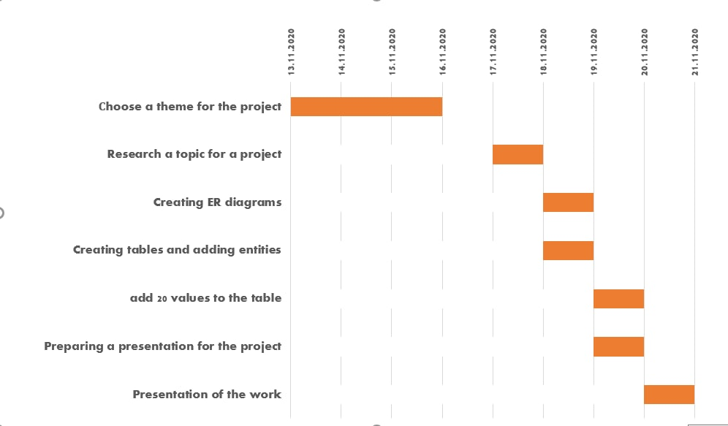

Slide 7
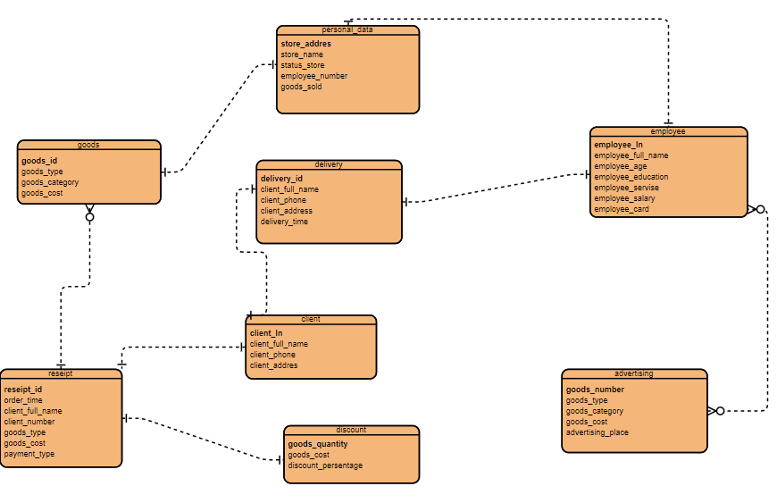
ER diagram

Slide 8
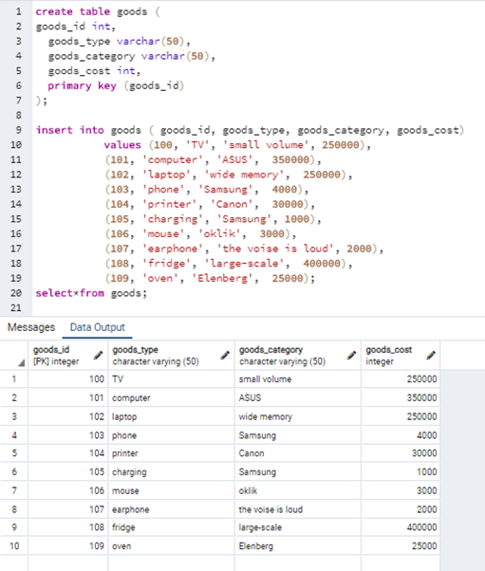
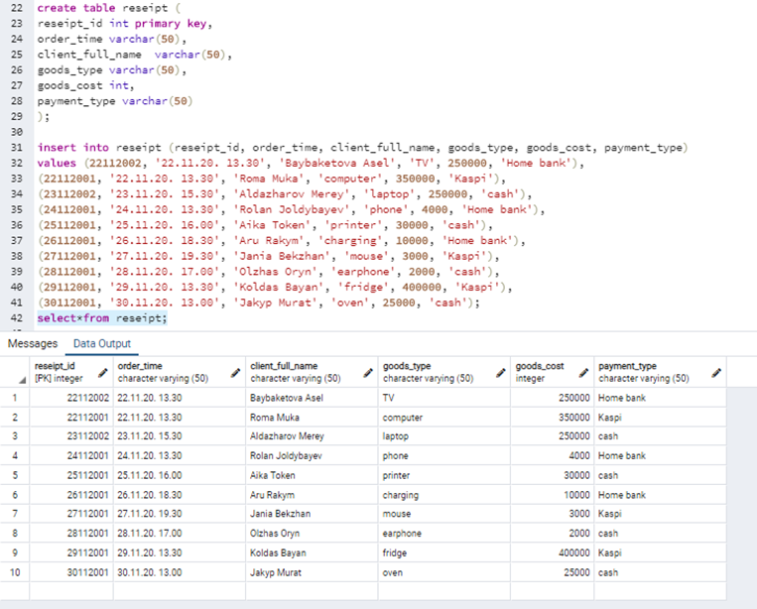

Slide 9
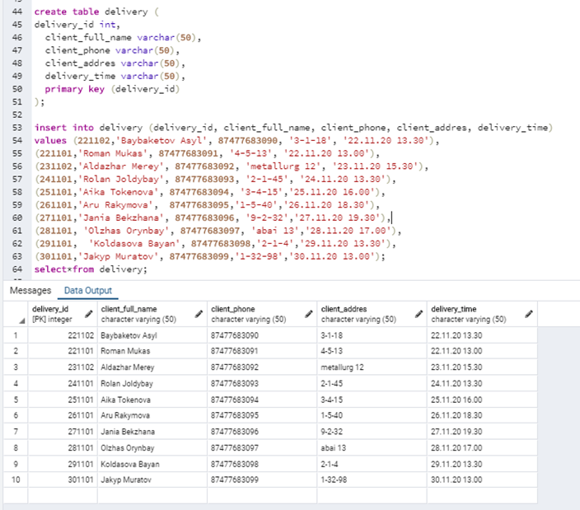
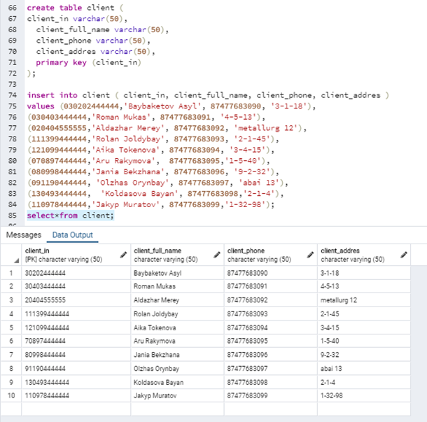

Slide 10
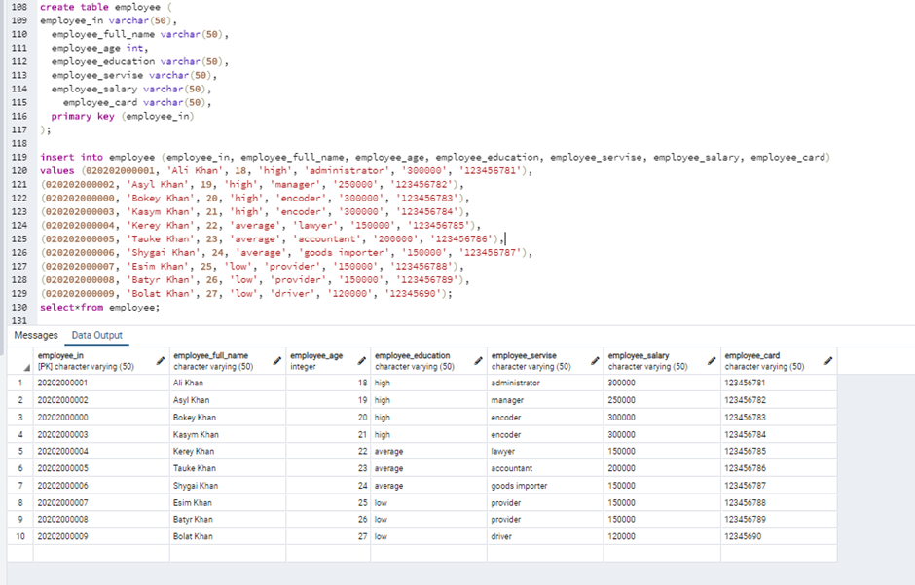
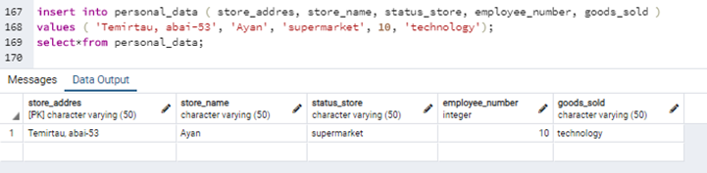

Slide 11
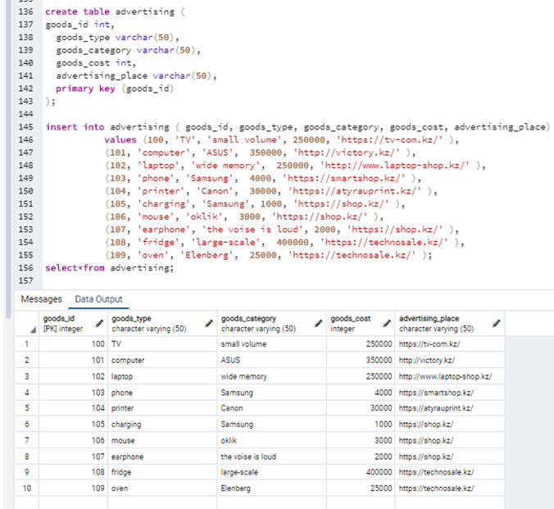
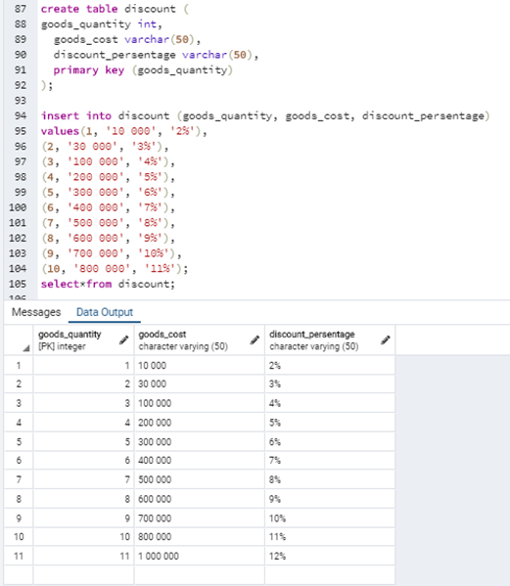

Slide 12


BENEFIT
What did I learn?
I got acquainted with the methods of creating a project
I understood the type of communication of the project
I was able to use my programming knowledge with SQL for special purposes

Slide 13

CONCLUSION
In conclusion, the advantage of the project is the creation of a database system that is necessary for any institution, so it is widely distributed in developed countries.

Slide 14


